Slide 1

YOUTUBE VIDEOS: SENTIMENT ANALYSIS AND TREND PREDICTION
PRESENTERS:
ALKA KUMARI, SHIVANI RAUT AND TINA JOSEPH

Slide 2

INTRODUCTION
YouTube is one of the world's largest social networking and video-sharing websites.
A platform where people can upload videos, watch videos, and can also receive feedback in the form of likes, comments, and several shares, from the audience.

Slide 3

CONTENT INDEX
Introduction
Technology Used
Project Brief
Objectives
Steps Followed
Future Scope

Slide 4
TECHNOLOGY USED
Spark SQL,Spark ML, Pyspark
Google Colab, Github
Python (Pandas, Plotly, sklearn, matplotlib, seaborn)
NLP(nltk,TextBlob)

Slide 5
PROJECT BRIEF
In this project,
We are trying to examine the relationships and importance of interactive features on YouTube like views, likes, dislikes, comment counts that affect the trendiness of a video.
Performed Sentiment Analysis on the Comments
Prediction of Trending period of Youtube videos using Random Forest
Prediction of sentiments using Logistic Regression
Emoji Analysis from Youtube video Comments

Slide 6
OBJECTIVES
Find out the factors affecting the sentiments of YouTube comments and the trend and performed visualization on it
Analyze the connection between sentiments and the trend of the video.
To perform Sentiment analysis on comments received on a YouTube Video.
Understanding the statistics of the Emojis in comments.
Predicted the comment sentiments using logistic regression.
Predicting the duration of the trend or the time it will take for the video to become popular

Slide 7


OBJ. CONTINUED
Why sentiment analysis:
YouTube analysis will allow a user to analyze data about their target audience, their posts, and their channel's performance overall. Using these engagement metrics a user can create a content strategy that will encourage channel growth.
Comments: With the help of this sentiment analysis of comments, the user can get to know about the community acceptance of its channel/video based on that one can maintain the content quality.

Slide 8
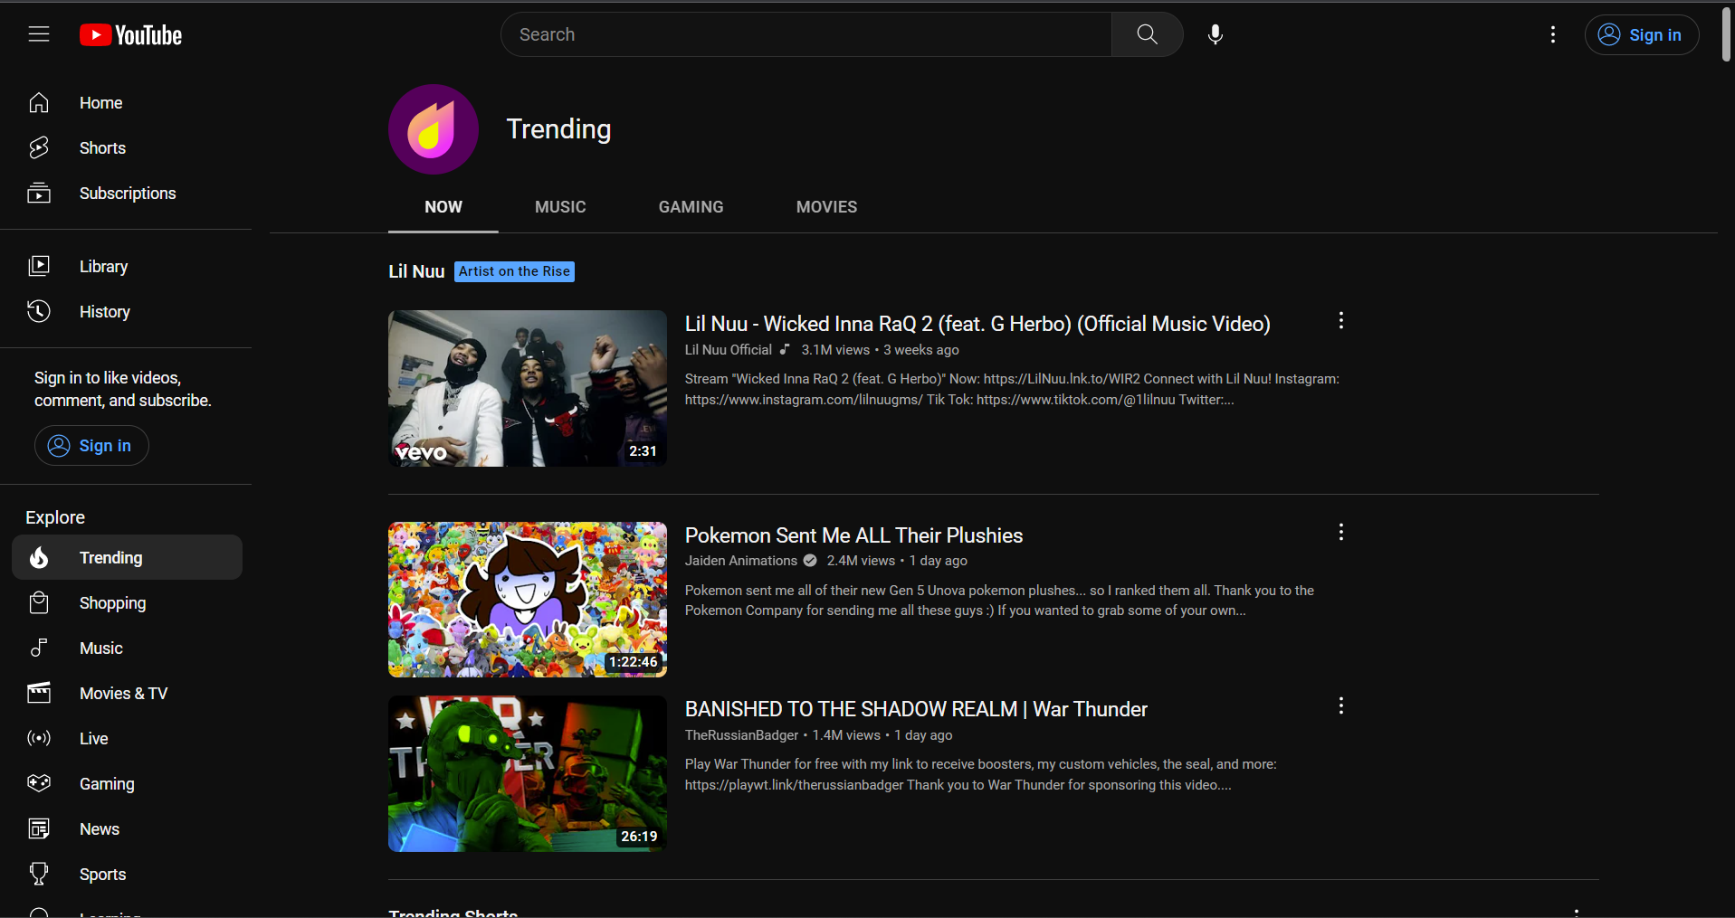

Slide 9

STEPS FOLLOWED
1.Data Understanding
2.Data Preparation
Data Cleaning
Data Preprocessing/Analysis
Creation and Relevant Feature Selection
3.Training the model
4.Evaluating the model

Slide 10
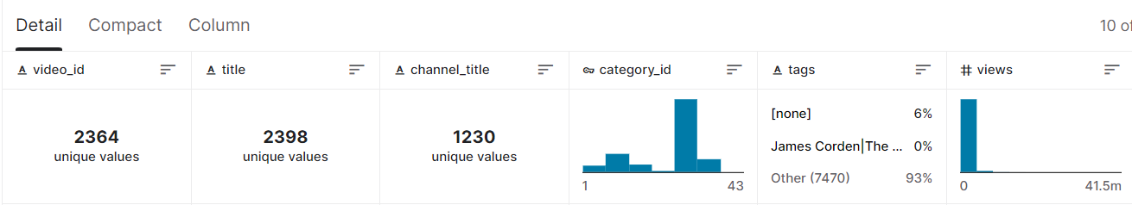
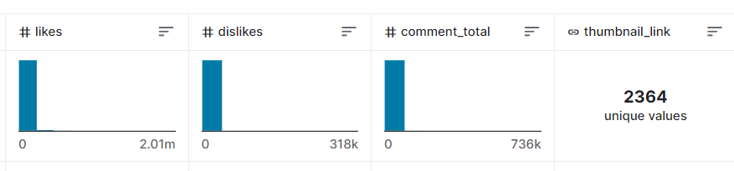
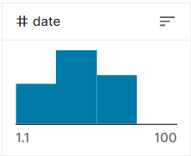
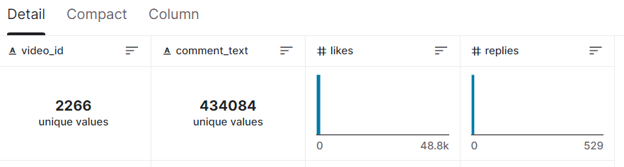
UNDERSTANDING DATASET: FOR SENTIMENT
The dataset includes data gathered from videos on YouTube that are contained within the trending category each day. There are two kinds of data files, one includes comments, and one includes video statistics.
Columns in Video Statistics file:
Columns in Video comments file:

Slide 11
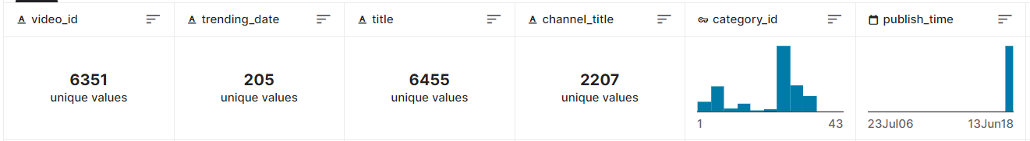
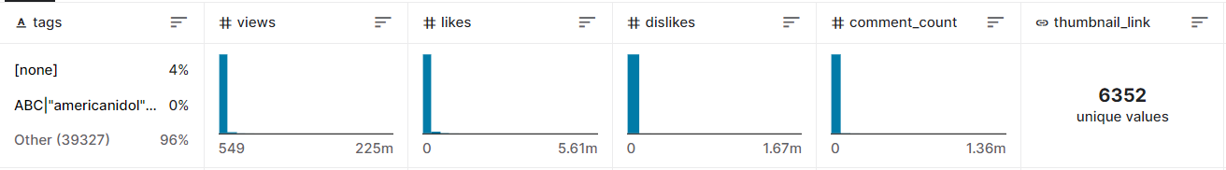
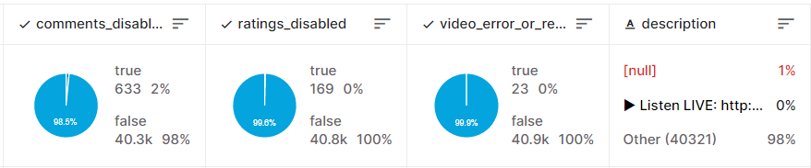
UNDERSTANDING DATASET: FOR TREND
The dataset includes data gathered from all the countries YouTube videos. It contains trending category. There are two kinds of data files for each country, one includes video statistics and category json for category ID.
Columns in Video Statistics file:

Slide 12
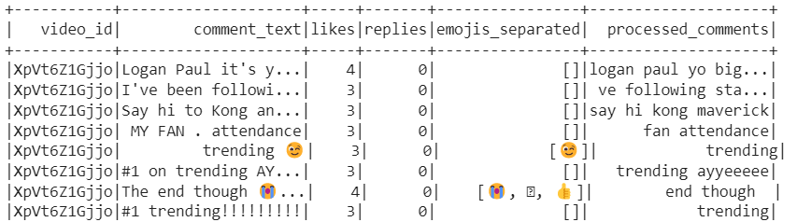
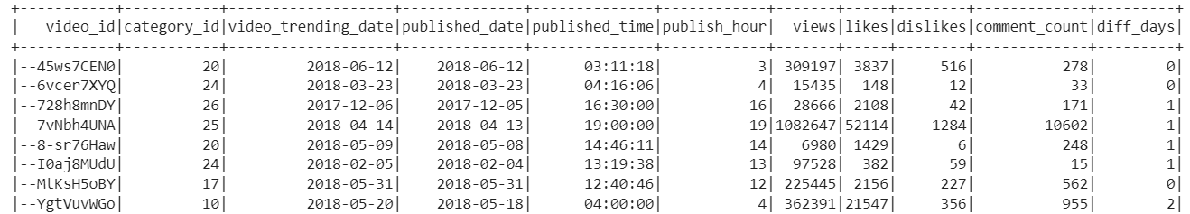
DATA CLEANING-EMOJIS & COMMENTS
DATA CLEANING-TRENDING VIDEOS
Notes:
Nltk- punct and stopwords removal, spark UDF – emoji extraction from comments

Slide 13
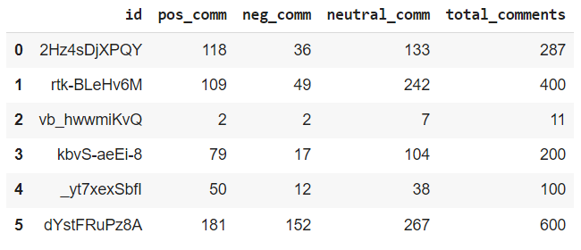
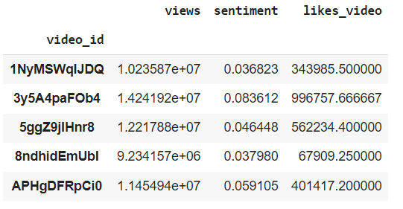
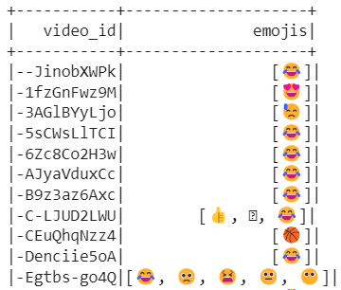
DATA PREPROCESSING-COMMENTS SENTIMENT ANALYSIS
DATA PREPROCESSING- TRENDING VIDEOS

Slide 14
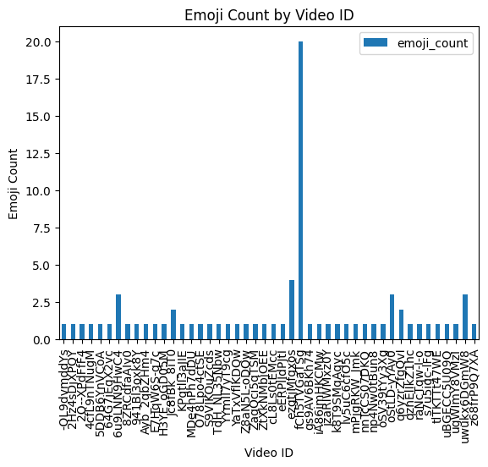
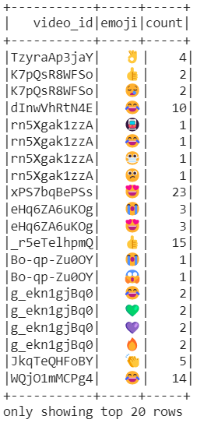
EXPLORATORY DATA ANALYSIS: Emojis
Notes:
This shows the count of emojis used in each videos and the statistics of that is shown here.

Slide 15
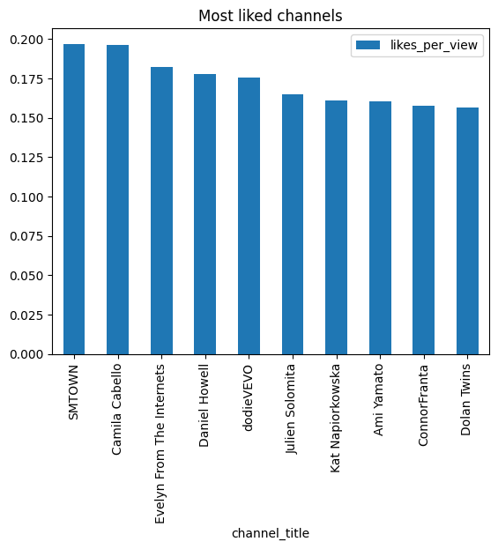
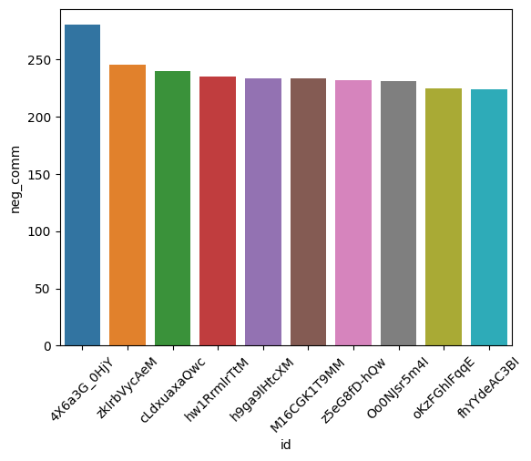
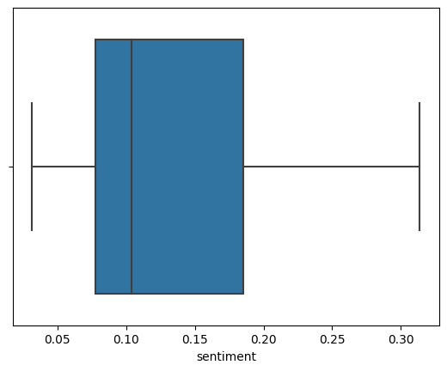
EXPLORATORY DATA ANALYSIS: Comments
Notes:
Explain about the visualization and how we have used it.

Slide 16
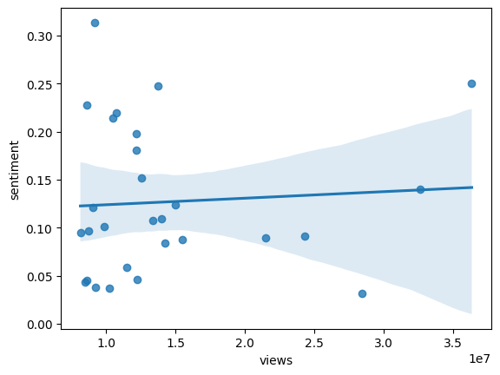
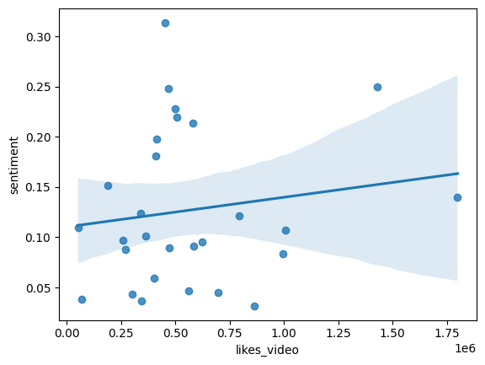
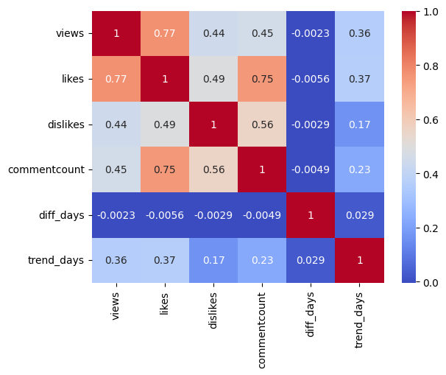
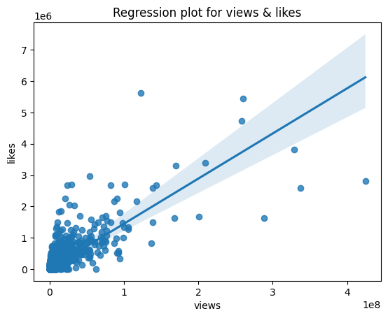
EXPLORATORY DATA ANALYSIS:
Sentiment with Trend

Slide 17
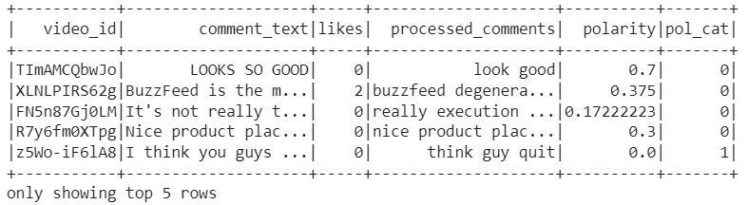
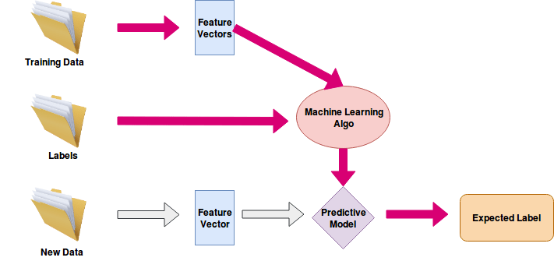
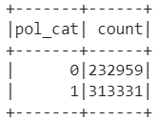
MODELS - SENTIMENT PREDICTION
Training Data
Logistic Regression
Training Data
Labels

Slide 18
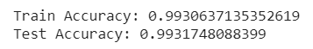
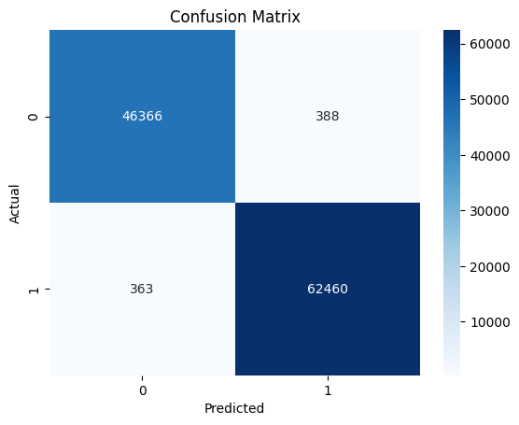
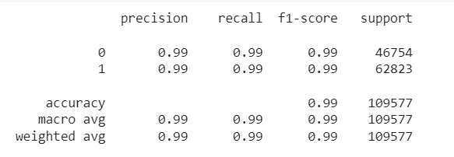
MODEL EVALUATION AND RESULTS: SENTIMENT PREDICTION
MulticlassClassificationEvaluator()
confusion_matrix ()
INGOUDE COMPANY
0: Positive Comment Sentiment
1: Negative Comment Sentiment
classification_report()

Slide 19
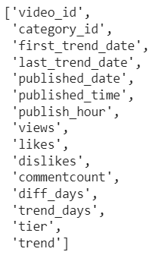
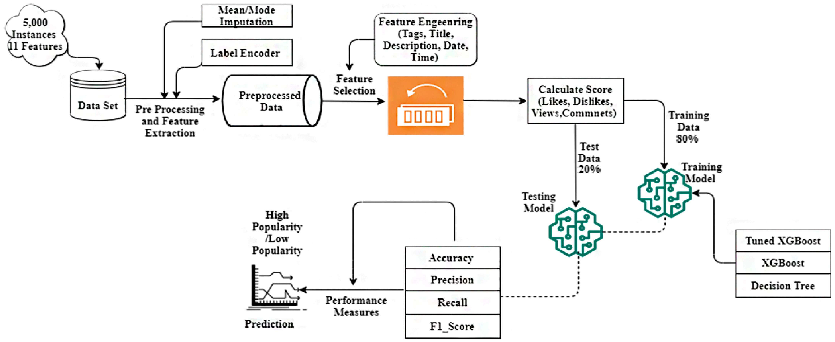
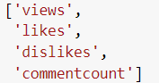
MODELS - TREND PREDICTION
Preprocessed Data
Training Data
Features
Random Forest Regression

Slide 20
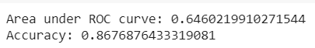
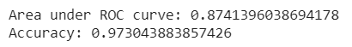
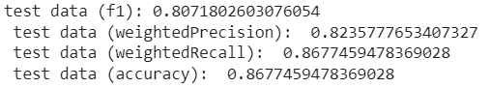
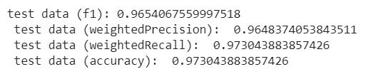
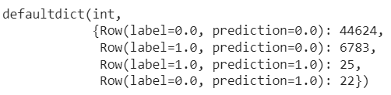
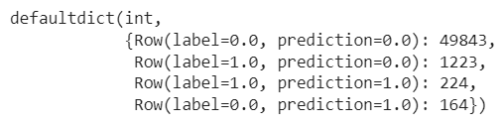
MODEL EVALUATION AND RESULTS:
Trend PREDICTION
Number of days video will take to trend
Number of days video will be trending
MulticlassClassificationEvaluator()
MulticlassClassificationEvaluator()
Confusion Matrix
Confusion Matrix

Slide 21
FUTURE SCOPE
Sentiment Analysis using BERT
BERT (Bidirectionnal Encoder Representations for Transformers) is a “new method of pre-training language representations” developed by Google and released in late 2018.
Website can be made where you-tuber can monitor the statistics through Dashboards of their videos. The Dashboards will show the predictions of the Trend and Sentiments of the videos.
Sponsors or the Advertisers of the you-tube channel can take the decisions to sponsor/advertise on specific you-tube channel based on the predictions.

Slide 22
REFERENCES
Sentimental Analysis using Logistic Regression: https://www.ijera.com/papers/vol11no7/Ser-2/F1107023640.pdf
YouTube Videos Prediction: Will this video be popular?: https://cs229.stanford.edu/proj2019aut/data/assignment_308832_raw/26647615.pdf
LSTM, VADER and TF-IDF based Hybrid Sentiment Analysis Model: https://thesai.org/Downloads/Volume12No7/Paper_30-LSTM_VADER_and_TF_IDF_based_Hybrid_Sentiment.pdf
On the Reusability of Sentiment Analysis Datasets in Applications with Dissimilar Contexts: https://www.ncbi.nlm.nih.gov/pmc/articles/PMC7256387/
A Comparative Study on TF-IDF Feature Weighting Method and its Analysis using Unstructured Dataset: https://ceur-ws.org/Vol-2870/paper10.pdf
Real-time Twitter Sentiment Analysis for Moroccan Universities using Machine Learning and Big Data Technologies: https://online-journals.org/index.php/i-jet/article/view/35959
Social media analytics for YouTube comments: potential and limitations: https://www.tandfonline.com/doi/abs/10.1080/13645579.2017.1381821?journalCode=tsrm20
How useful are your comments? Analyzing and predicting YouTube comments and comment ratings: https://www.researchgate.net/publication/221023733_How_useful_are_your_comments_Analyzing_and_predicting_YouTube_comments_and_comment_ratings
Visualizing YouTube’s comment space: online hostility as a networked phenomena: https://journals.sagepub.com/doi/pdf/10.1177/1461444818792393

Slide 23
Thank You...

